Slide 1

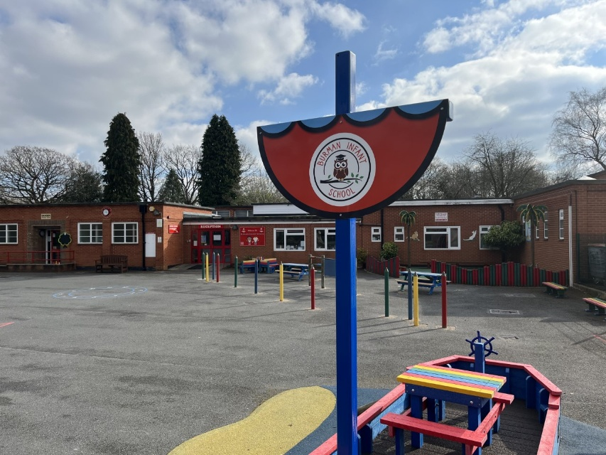
Welcome to Burman
Thank you for choosing us for your child’s first steps of their educational journey

Slide 2
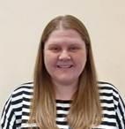
Mrs Greensmith

Slide 3
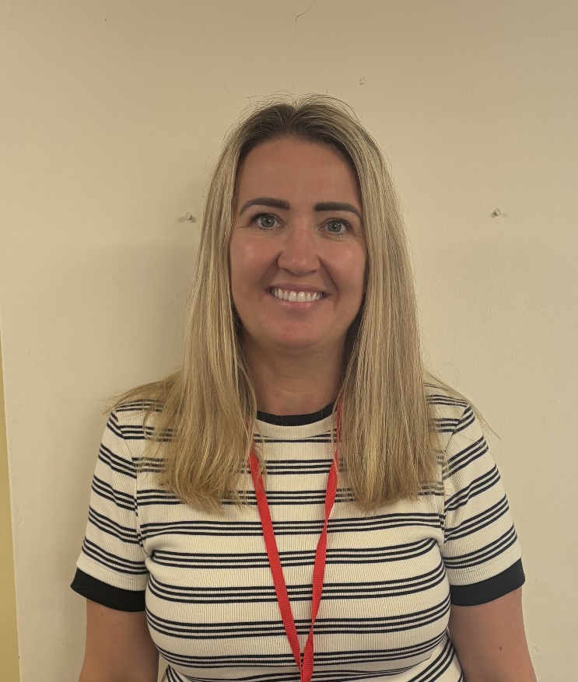
Mrs McVeigh

Slide 4
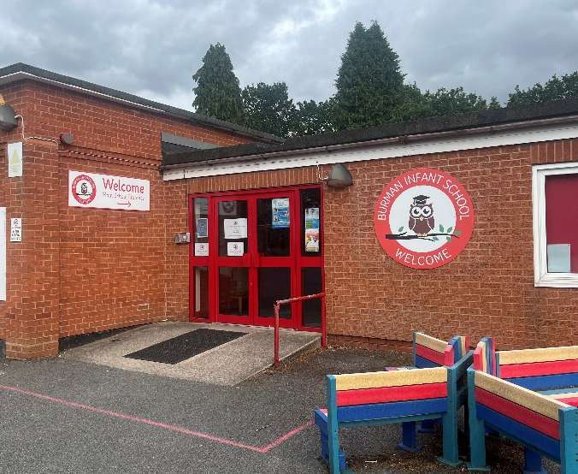
Nursery Induction Sessions
In your information pack, you will find
details of the Induction process at Burman.
These include;
Your initial visit to our Nursery setting, this week.
Your Child’s Home Visit (September).
A ‘Stay and Play’ session (September).
A 1hr group session for your child to attend during
the first week of term.
Full 3-hour sessions from will begin from
Monday 7th September 2026

Slide 5

Little Owls
Burman’s Wraparound Provision
12 noon – 3:00pm (with the option of extending until 3:30pm)
Early Years Funding or paid option
Chargeable hot lunch or packed lunch
Flexible offer

Slide 6

The EYFS Curriculum
The EYFS curriculum is delivered in an interactive way, enabling children to learn through play.
We have Focused activities (adult led) and Free Flow / Continuous Provision activities (free choice).
The principles we apply are:
Each child is unique,
We nurture positive relationships,
We prepare an enabling environment as the context for children to learn and explore.

Slide 7
EYFS Curriculum Overview
What your child will do
Seven Key Areas of Learning:
Personal, Social and Emotional Development
2. Communication, Language and Literacy
3. Physical Development
4. Literacy
5. Mathematics
6. Understanding the World
7. Expressive Arts & Design

Slide 8
Prime Areas of the Curriculum
Personal, Social and Emotional
Development
Form positive relationships with adults and children through a variety of activities
Develop language skills and confidence through play and focus activities
Learn to follow rules and work alongside others
Support children in the development of their resilience, independence and perseverance skills
Manage their own basic hygiene and personal needs.

Slide 9
Prime Areas of the Curriculum
Communication, Language and Literacy
Listen to stories and join in with discussions
Answer questions and talk about own experiences
Learn to express themselves effectively in a variety of social situations
Express their ideas and feelings in full sentences, including use of past, present and future tenses.

Slide 10
Prime Areas of the Curriculum
Physical Development
Learn to move in a variety of ways through PE sessions and outdoor opportunities
Demonstrate strength, balance and co-ordination when playing
Develop pencil skills for handwriting
Use a range of small tools including scissors, paintbrushes and cutlery

Slide 11

Little Wandle
Foundations for Phonics
To give every child the best possible start to their reading journey
To build the foundations for children to succeed with phonics in Reception
Little Wandle’s Tuning into sounds and Rhyme time activities
Phonics is making connections between the sounds (phonemes) of our spoken words and the letters that are used to write them down (graphemes).

Slide 12
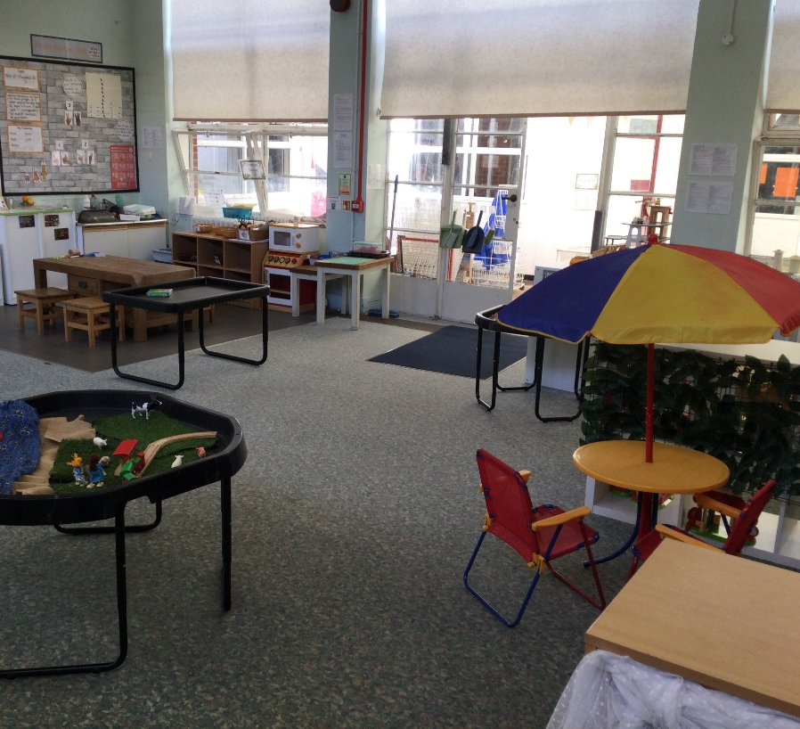
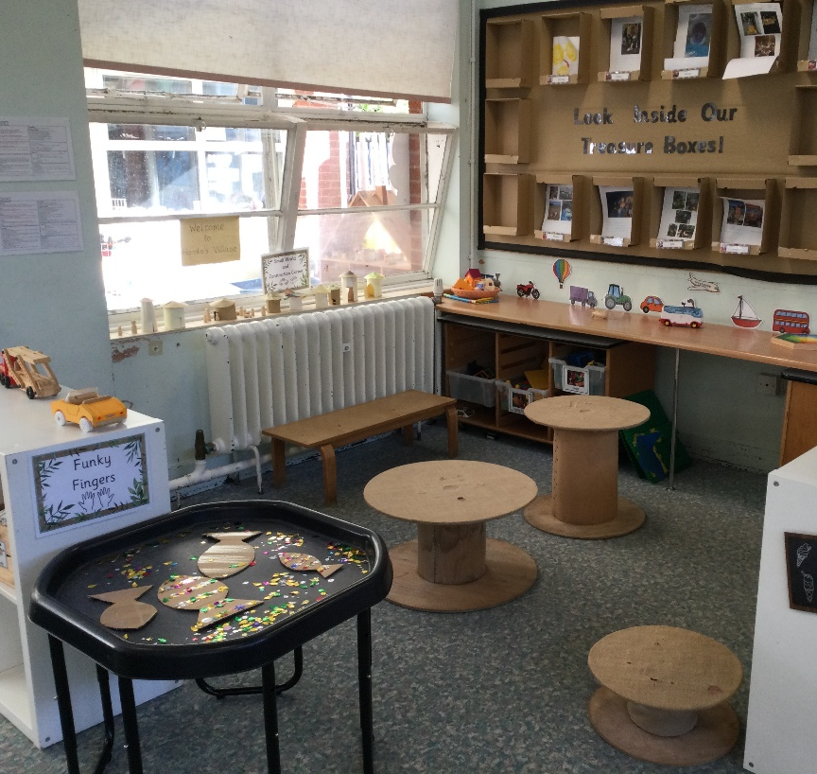
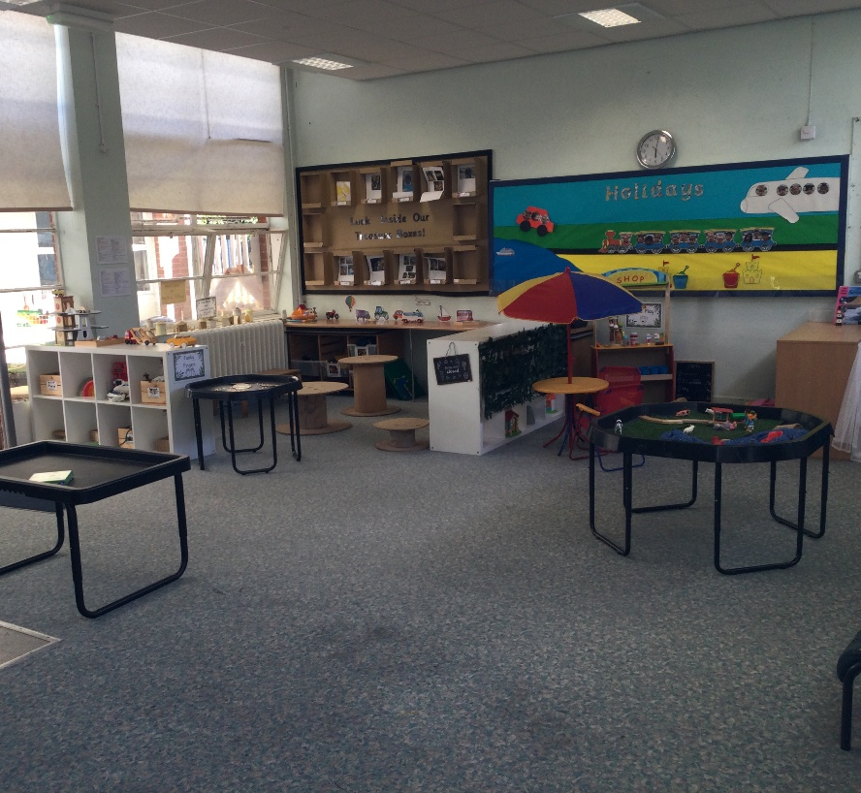
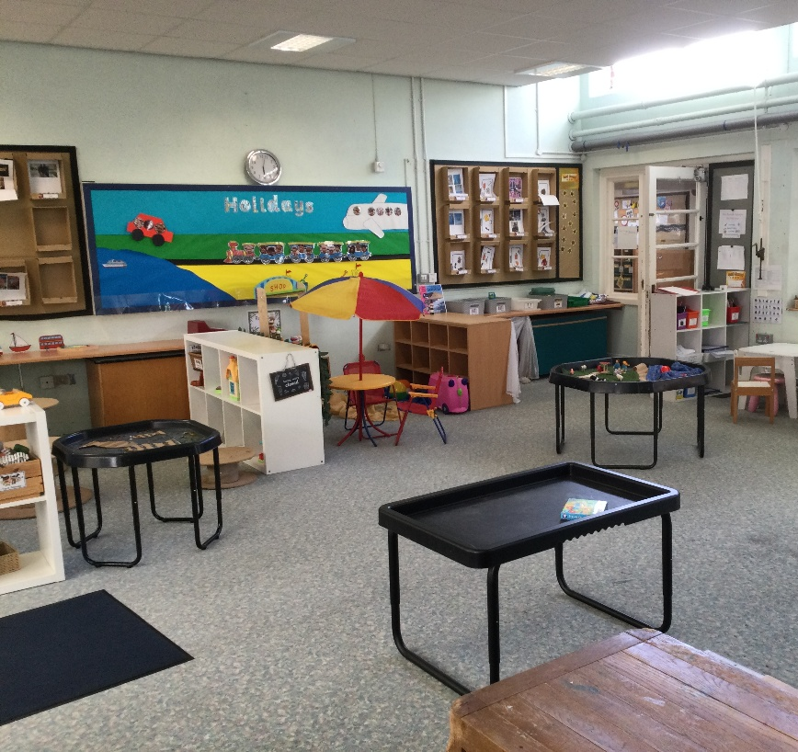
Classroom and
Outdoor Areas

Slide 13
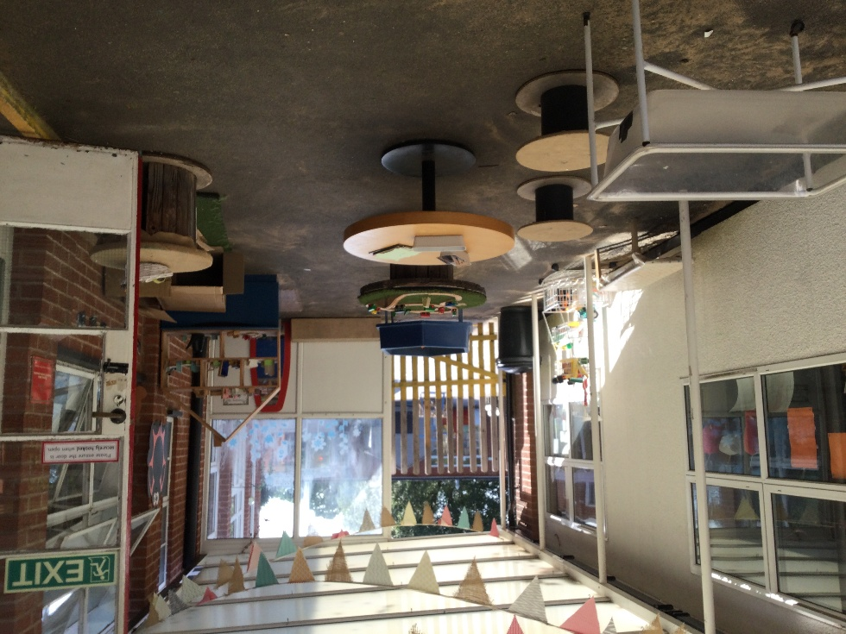
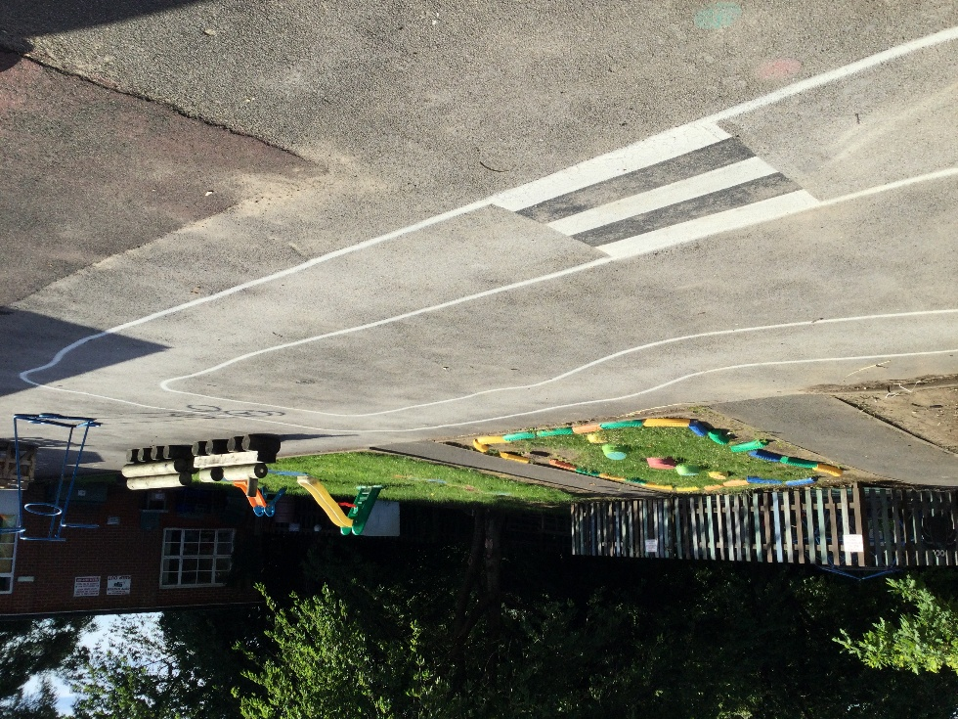
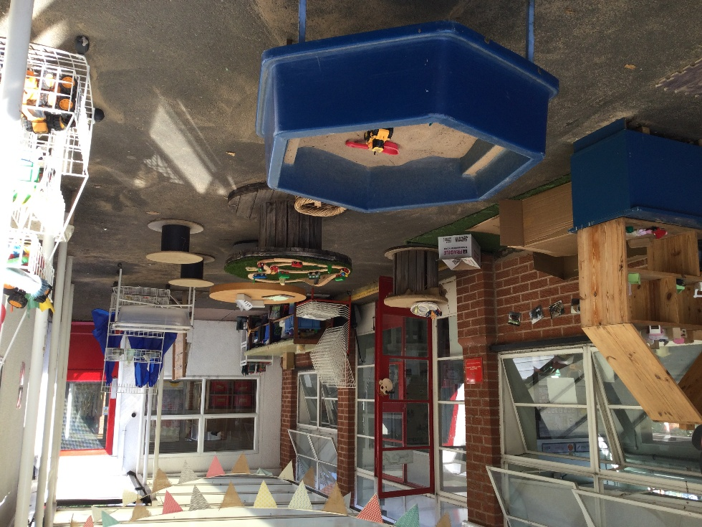
Classroom and Outdoor Areas

Slide 14
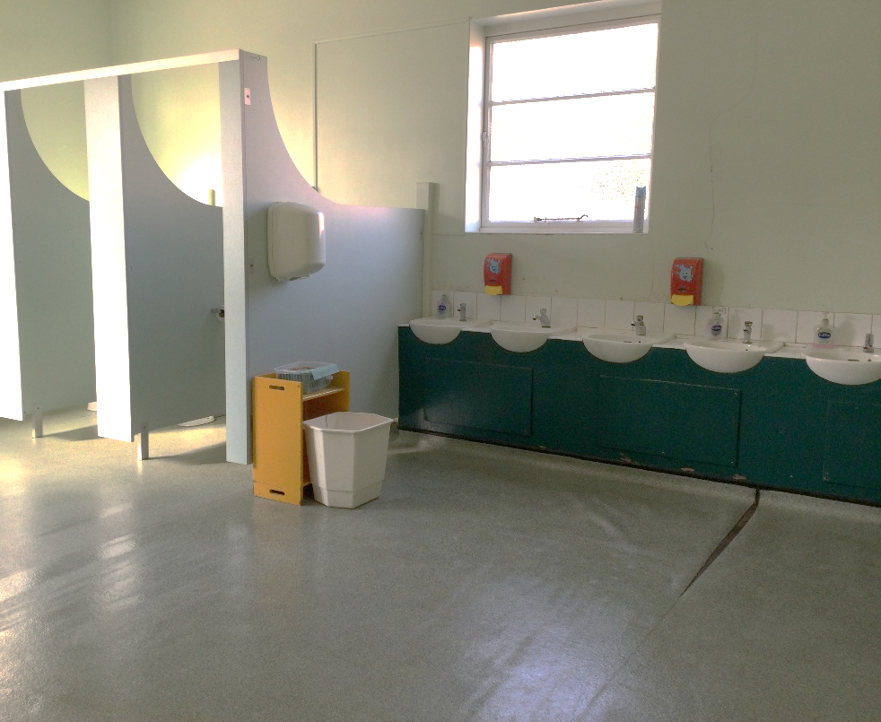
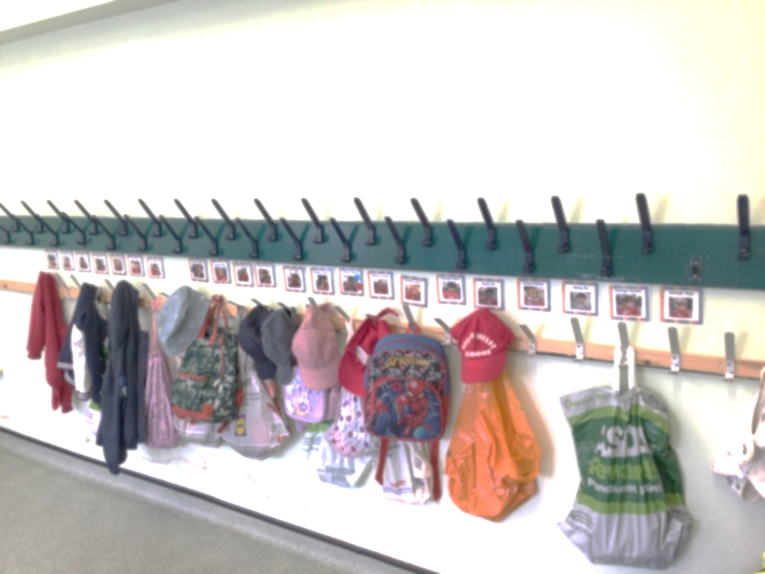
Cloakroom and Toilets

Slide 15
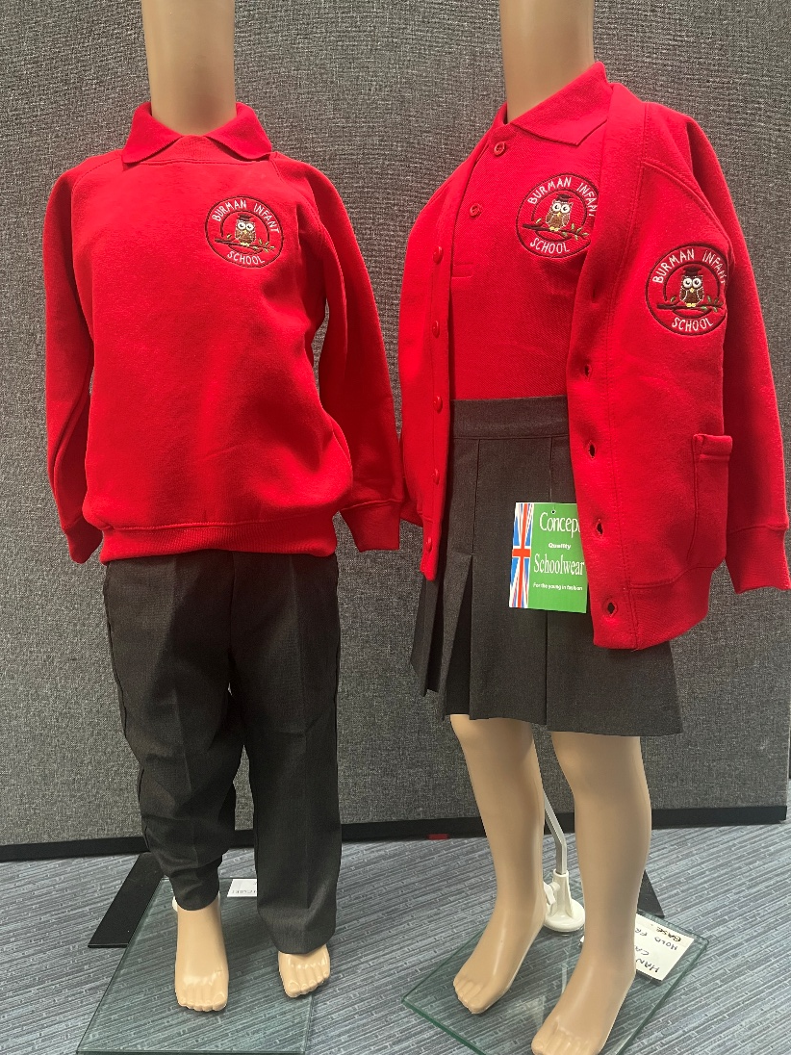
School Uniform
Red polo shirt
Grey trousers / skirt
Burman sweater / cardigan
Black shoes (no laces)
Please label all items with your child’s name.

Slide 16
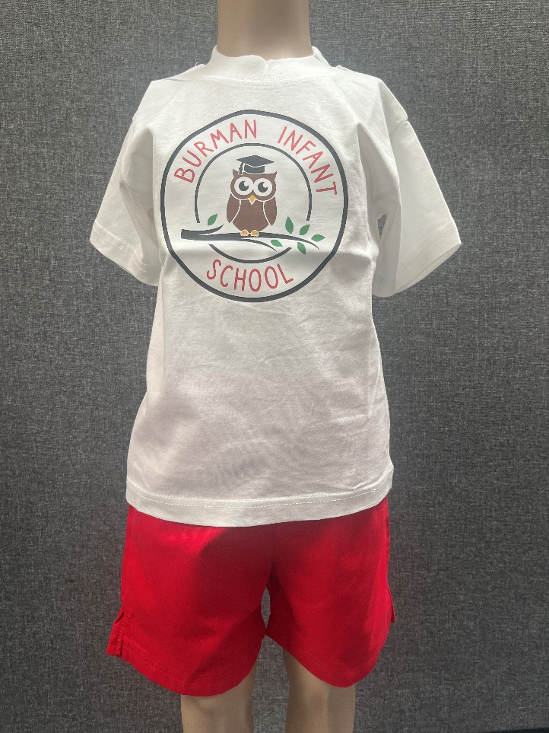
PE Kit
On your child’s PE days please can they come dressed in the following:
White t-shirt
Burman sweater or cardigan
Black leggings or joggers
(red shorts in the summer)
Trainers (preferably black)
Your PE days will be confirmed in September.
Please label all items with your child’s name.

Slide 17
Preparing for Nursery
What can I do to help my child prepare?
Support your child to be both toilet trained and use the toilet independently where possible
Encourage independent hand washing
To help them to learn to take off and put on their own coat
Support your child to share with others and take turns

Slide 18
Preparing for Nursery
To help develop your child’s organisational and independent skills for the school day such as carrying their own bag, being able to open their bag and place things in there
Encourage your child to recognise their own belongings such as coat, lunch box and water bottle. Please label everything with their name!
Share books together, help your child to develop a love of books
Sing number rhymes together and encourage your child to recognise numbers in their environment

Slide 19
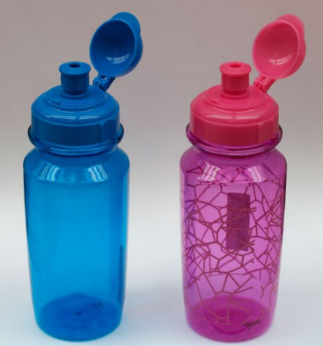
Everyday essentials…
In school, your child will need;
A filled, see through water bottle (no straps or strings please)
We have wellies in school but please feel free to bring in your own if you would like to.
1 clear recent photo of your family including your child.
Please label all items with your child’s name.

Slide 20
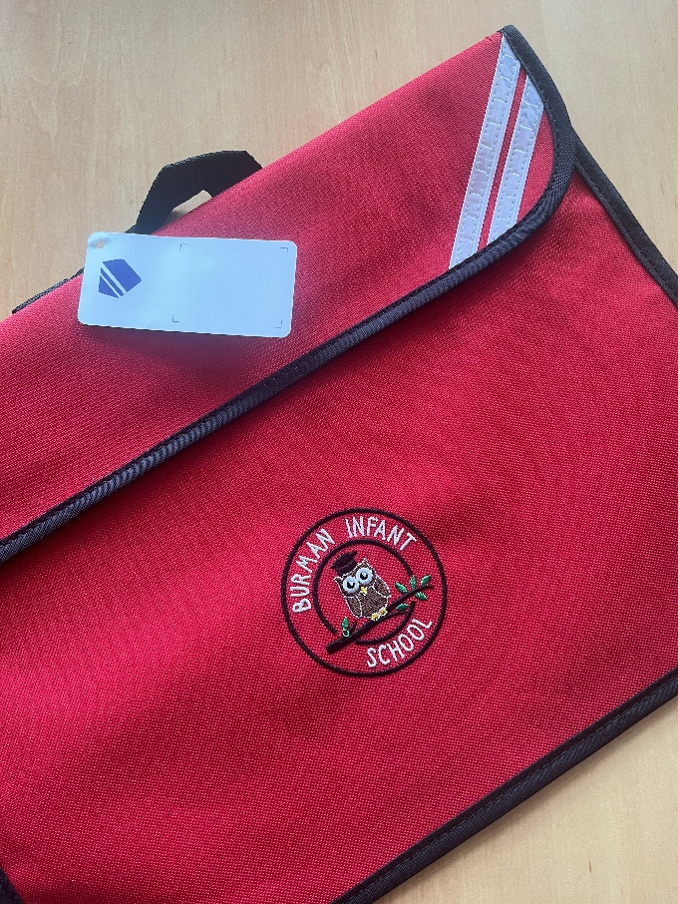
Book Bags
Your child will be given their Burman Book Bag.
Please check this daily for letters and messages.
Please carry water bottle separately (i.e. not in the book bag).
Please label with your child’s name.

Slide 21

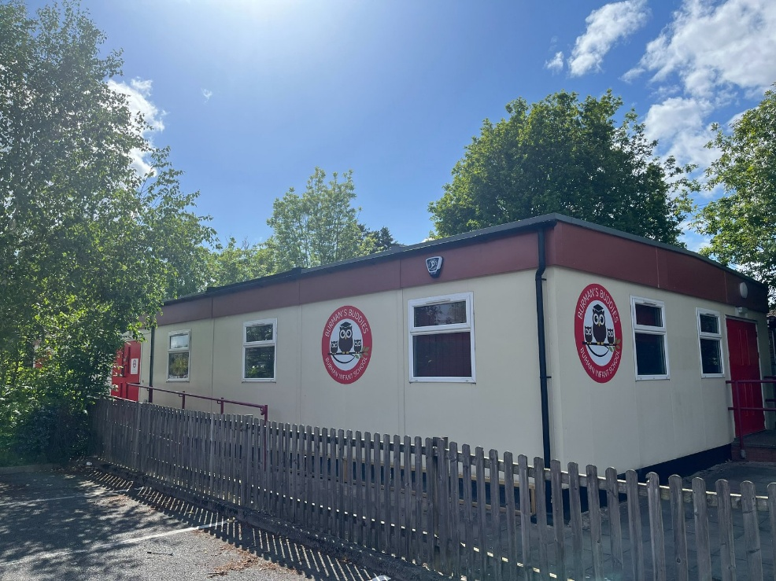
Burman’s Buddies
Opening Hours
Burman’s Buddies operates Monday to Friday during term time only:
Before School: 8:00am – 8:55am / 9:00am (Nursery)
After School - Early: 3:30pm – 4:30pm
After School – Standard: 3:30pm – 5:00pm
After School – Late: 3:30pm – 6:00pm

Slide 22

Health and Safety
Please bring any medicines to the School Office
(not in book bags).
We welcome birthday treats for the children but please ensure these are chocolate (nut free) and not lollipops/sweets.
Please note we are a nut free school.

Slide 23

Admission Forms
Please complete and return as soon as possible – thank you.

Slide 24
Thank you for coming.
We can’t wait to meet you!

